Slide 1
Musical Instrument Classification Using a Hybrid Neural Network
Landon Buell
Senior, B.S. Physics Major
University of New Hampshire
8 Jan 2020
Kevin Short
University Professor & Professor of Mathematics
Founder, Integrated Applied Mathematics Program
University of New Hampshire

Slide 2
Introduction

Slide 3
Mapping Sounds to Sources
Humans are proficient at mapping sounds to sources
Impractical at a large scale
Computers are not proficient at mapping sounds to sources
Can handle large volumes of data

Slide 4
“Birds inspired us to fly, burdock plants inspired Velcro and nature has inspired many other inventions. It seems only logical then, to look to the brain’s architecture for inspiration on how to build an intelligent machine.”
- Aurelion Geron, Former YouTube Video Classification lead

Slide 5
The Neural Network

Slide 6
Structure
A neural network is a mathematical function
Composed of smaller functions called layers
Transform features into predictions
May be the bottom of this slide could be a typical net, with linear algebra equivalent.

Slide 7
Classification Model
Inputs are mapped to qualitative outputs (musical instruments)
We group inputs that have similar properties
Integer output classes correspond to a musical instrument
Here we can reference the databases you used for the training data.

Slide 8
Existing Models
Inputs is 2D image-like array
Transformed through Convolution and Pooling Layers
Convolution Network

Slide 9
Existing Models
Input is 1D array of features
Transformed through Dense Layers
Multilayer Perceptron

Slide 10
Hybrid Network Architecture

Slide 11
Two Modes of Input
Each model uses a different input Modes
2D Spectrogram vs. 1D Feature Vector
Compare Modes to human senses

Slide 12
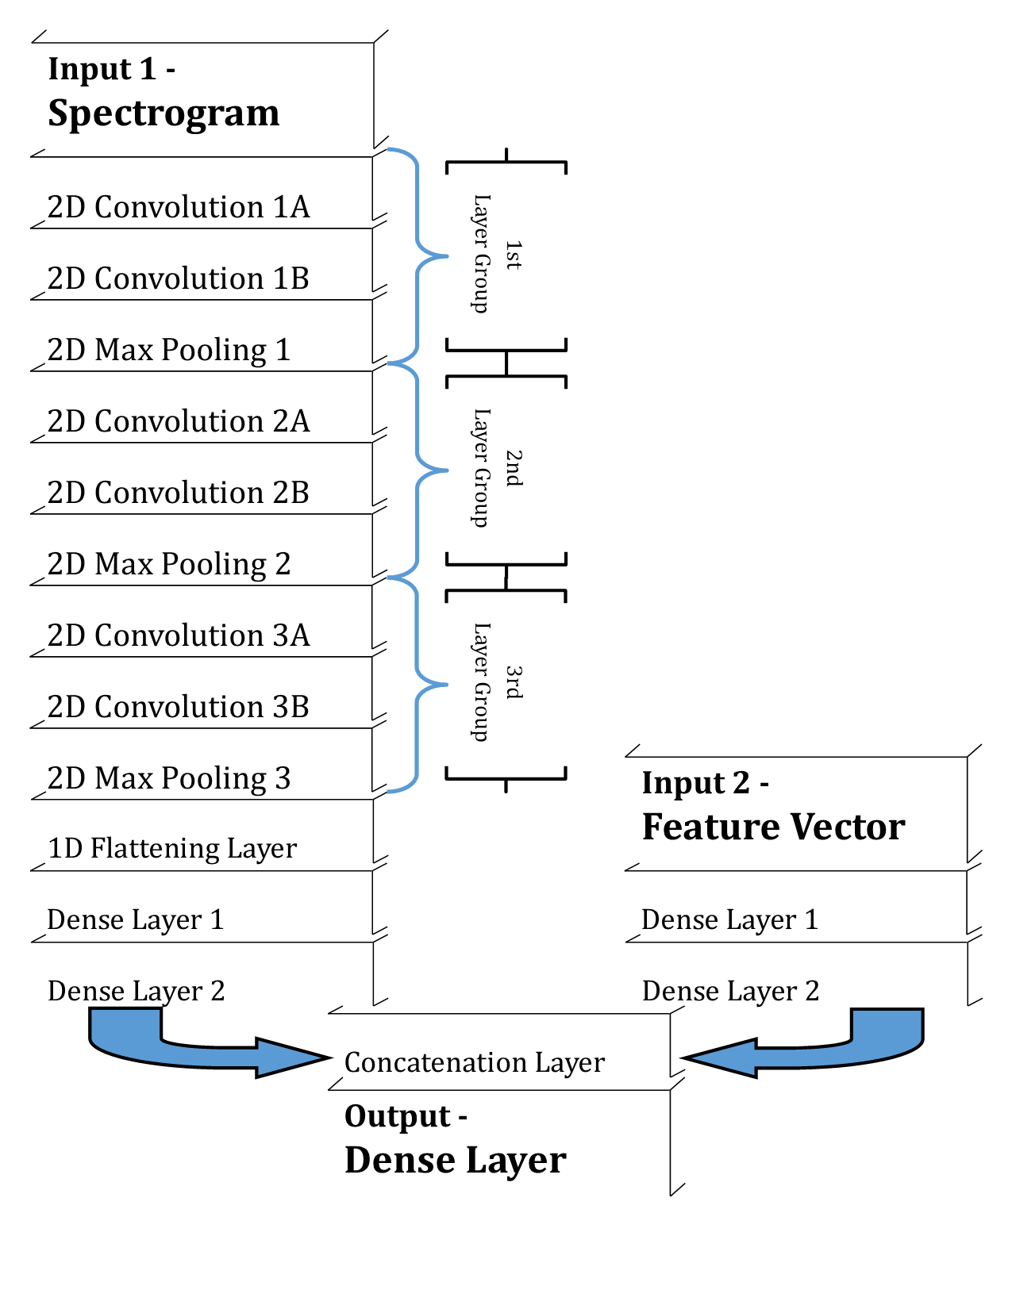
Hybrid Neural Network Architecture

Slide 13
Performance of the Hybrid Model

Slide 14
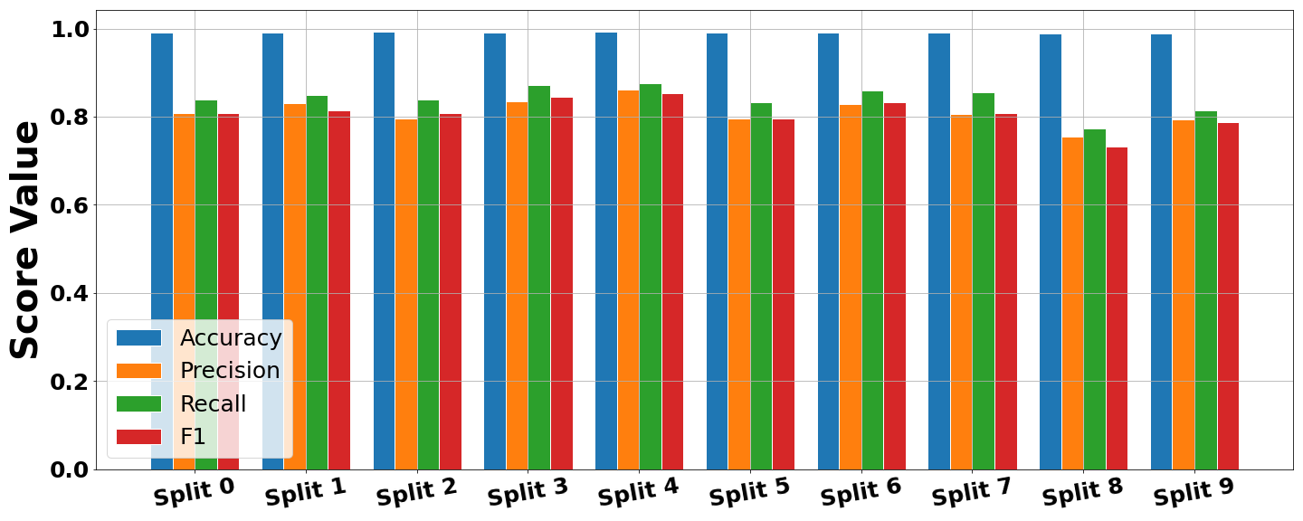
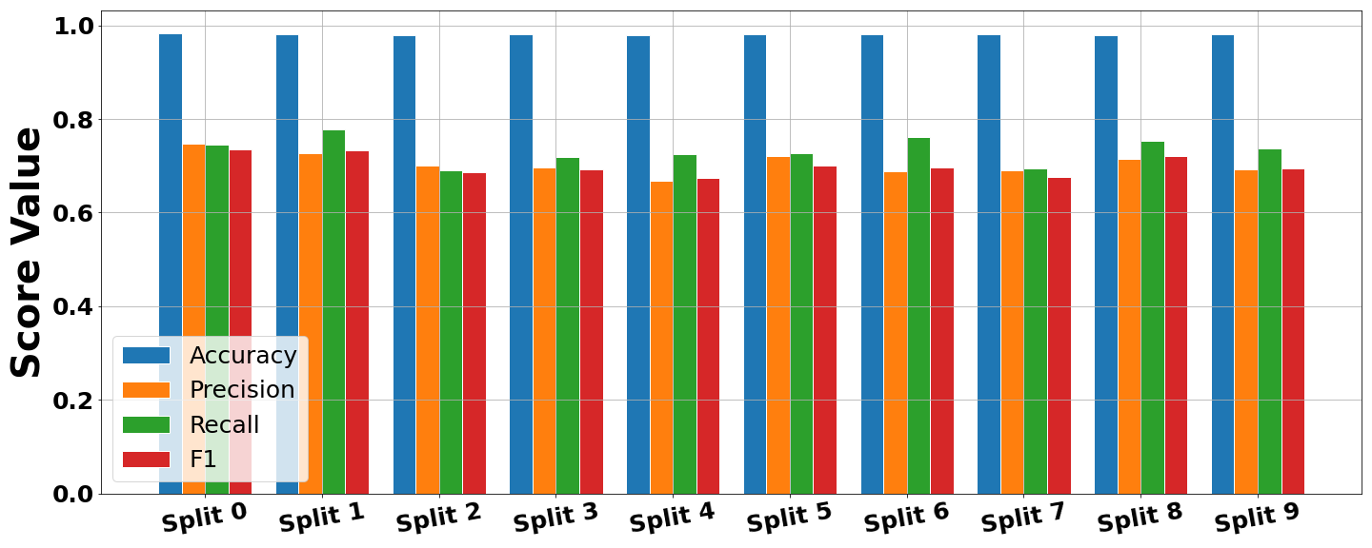
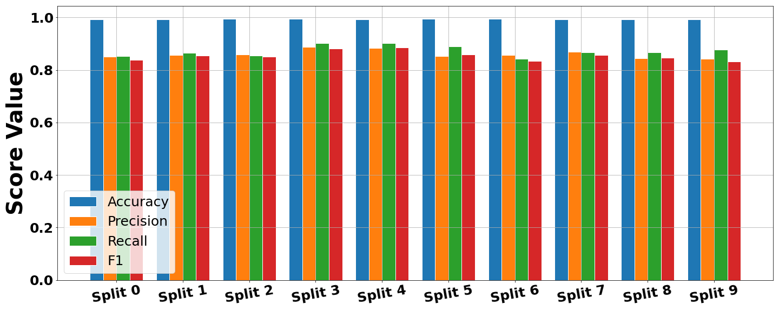
X-Validation Performance
1)
Three Separate Models’
Just CNN Architecture
Just MLP Architecture
Hybrid Architecture
Each unimodal achitecture learns a set of parameters
When combined, the
2)
3)

Slide 15
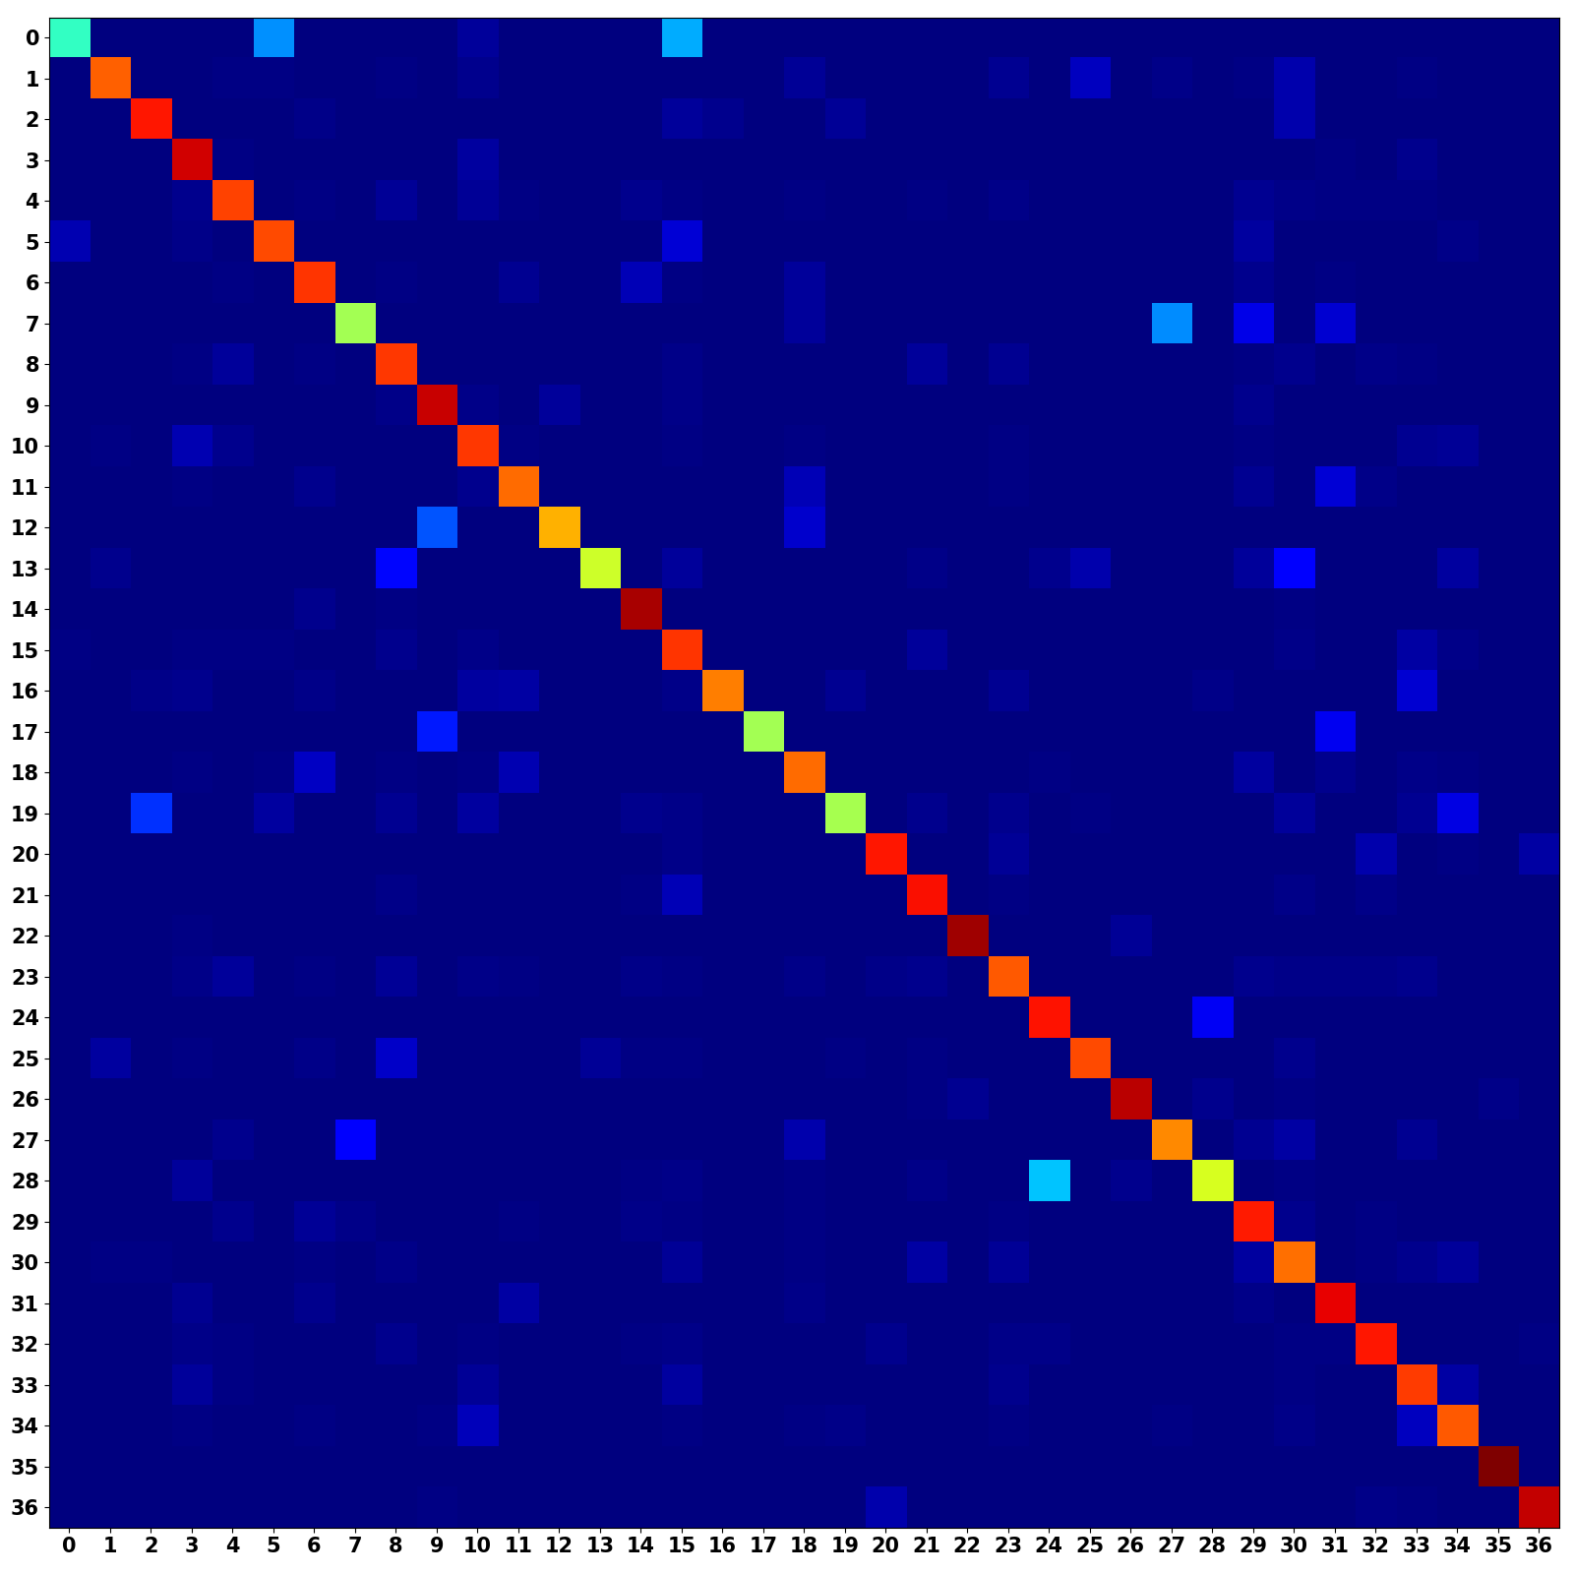
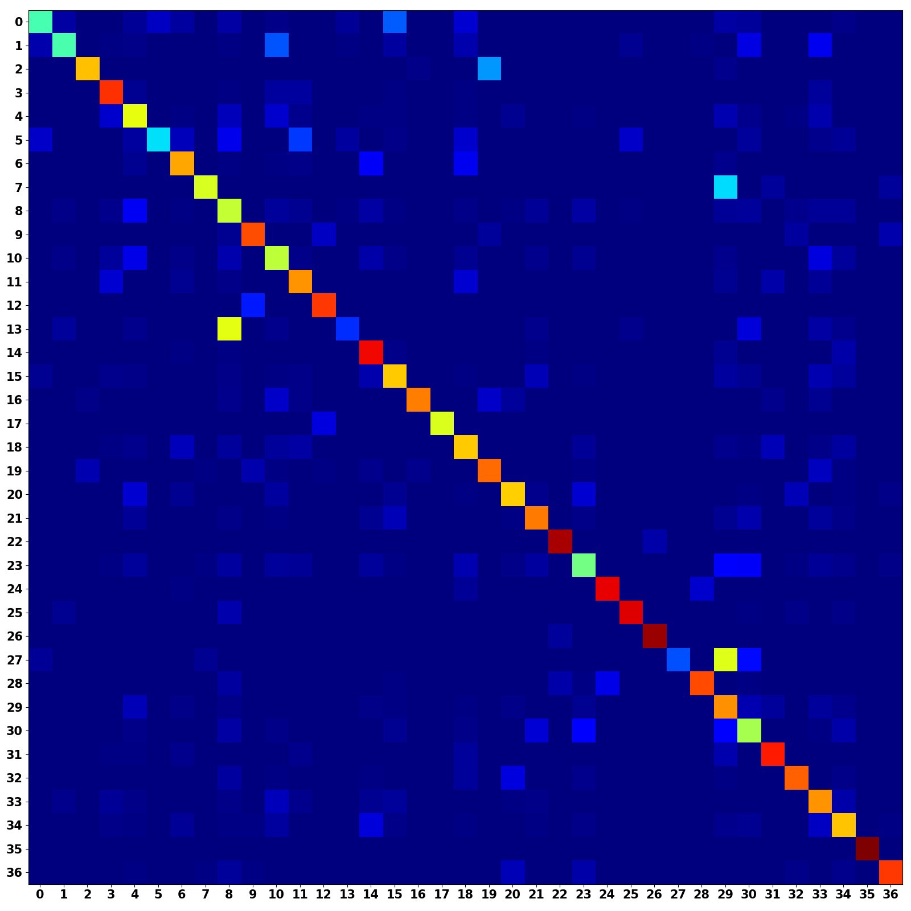
Unimodal Confusion Matrices
CNN Branch (Occurrence Weighted)
MLP Branch (Occurrence Weighted)

Slide 16
Multimodal Confusion Matrix
CNN + MLP (Occurrence Weighted)
Multimodal models shows a stronger main diagonal
Combines predictive power from both architectures

Slide 17
Discussions and Conclusions
Hybrid architecture allows for single sample to be effectively convey with two different input modes
The Multimodal Model Improves musical instrument classification performance
We would like to deploy this model to classify unlabeled chaotic synthesizer waveforms

Slide 18
Questions?
Additional information + Formal Write-up is available
Landon Buell – lhb1007@wildcats.unh.edu
Kevin Short – kevin.short@unh.edu
Project GitHub Repository:
https://github.com/landonbuell/Buell-Senior-Thesis

